Slide 1
Numbering systems

Slide 2
Overview
What is a numbering system?
Decimal
Binary
Hexadecimal

Slide 3
Some numbers that we already know
Natural numbers
Positive integers or all non-negative integers
Negative numbers
Set of values less than zero
Integers
Numbers that can be written without fractional or decimal component
Rational numbers
Any number that can be expressed as a division of two numbers.
Can also be an integer

Slide 4
Other numbers we might know
Irrational numbers
Can expressed as a/b, where a, b are integers and b not zero
Repeating decimals (PI)
Complex numbers
Expressed in the form of a+bi where i² = −1
Extends number line to two dimensional complex plane

Slide 5
What is a numbering system?
A numbering system is any notation for the representation of numbers
Symbols used come from a set of size n, where n = base
Each symbol is usually multiplied by the power of its base, depending on its position
Best shown by an example

Slide 6
Base 10 example
1394
1 x 10³ = 1 x 1000 = 1000
3 x 10² = 3 x 100 = 300
9 x 10¹ = 9 x 1000 = 90
4 x 10⁰ = 4 x 1 = 4
Or 1394 in base 10

Slide 7
Binary Numbers
Imagine only having a base of 2?
Computers use binary, which only uses on or off, where On = 1, Off = 0
Each binary digit is known as a bit
A binary number is represented the same as any other number system e.g. 101101

Slide 8
Counting binary
0 Start at 0
1 Then 1
10 Start back at 0 again, but add 1 on the left
11
100 Start back at 0 again, but add 1 on the left
101
110
111
1000 Start back at 0 again, but add 1 on the left
1001
…

Slide 9
Converting from binary to decimal
Convert 1011011₂ to decimal
1 x 2⁶ = 1 x 64 = 64
0 x 2⁵ = 0 x 32 = 0
1 x 2⁴ = 1 x 16 = 16
1 x 2³ = 1 x 8 = 8
0 x 2² = 0 x 4 = 0
1 x 2¹ = 1 x 2 = 2
1 x 2⁰ = 1 x 1 = 1
Ans?

Slide 10
Converting from decimal to binary
What is 79₁₀ in binary?
79/2 = 39 R1
39/2 = 19 R1
19/2 = 9 R1
9/2 = 4 R1
4/2 = 2 R0
2/2 = 1 R0
1/2 = 0 R1
79₁₀ = 1001111₂

Slide 11
A byte (0 – 255)
A byte in computers = 8 bits e.g. 11111111
1 x 2⁷ = 1 x 128 = 128
1 x 2⁶ = 1 x 64 = 64
1 x 2⁵ = 1 x 32 = 32
1 x 2⁴ = 1 x 16 = 16
1 x 2³ = 1 x 8 = 8
1 x 2² = 1 x 4 = 4
1 x 2¹ = 1 x 2 = 2
1 x 2⁰ = 1 x 1 = 1

Slide 12
Other facts
KBs, MBs, GBs all in powers of 2
Boolean and byte exist in all programming languages
Boolean algebra used throughout programming languages

Slide 13
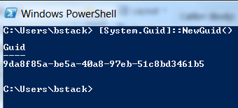
Hexadecimal
Base 16
Uses characters 0-9, A-F
Used quite often in computer science
UUIDs (sometimes called GUIDs)

Slide 14
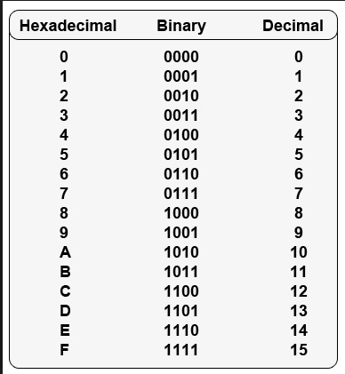
Hex/Bin/Dec table
Example:
D₁₆ = 1101₂ = 13₁₀

Slide 15
Converting binary to hex
101₂ = 5₁₆
Convert (0100101000000001)₂ to hex:
(0100)₂ = (4)₁₆
(1010)₂ = (A)₁₆
(0000)₂ = (0)₁₆
(0001)₂ = (1)₁₆
(0100101000000001)₂ = (4A01)₁₆

Slide 16
Converting hex to binary
Convert (4A01)₁₆ to binary:
(4)₁₆ = (0100)₂
(A)₁₆ = (1010)₂
(0)₁₆ = (0000)₂
(1)₁₆ = (0001)₂
(4A01)₁₆ = (0100101000000001)₂
How do you convert from hex to decimal?

